Slide 1

Introduction to IT Project Management and Entrepreneurship
Lecture 5
Deepak Chandra Roy
Adjunct Faculty, CSE, EWU
deepak.kth@gmail.com
01685441156

Slide 2
Agenda
Scrum
Kanban

Slide 3
Scrum has been used by
Microsoft
Yahoo
Google
Electronic Arts
IBM
Lockheed Martin
Philips
Siemens
Nokia
Capital One
BBC
Intuit
Apple
Nielsen Media
First American Corelogic
Qualcomm
Texas Instruments
Salesforce.com
John Deere
Lexis Nexis
Sabre
Time Warner
Turner Broadcasting
Oce

Slide 4
Scrum has been used for
Commercial software
In-house development
Contract development
Fixed-price projects
Financial applications
ISO 9001-certified applications
Embedded systems
24x7 systems with 99.999% uptime requirements
the Joint Strike Fighter
Video game development
FDA-approved, life-critical systems
Satellite-control software
Websites
Handheld software
Mobile phones
Network switching applications
ISV applications
Some of the largest applications in use

Slide 5
Characteristics
Self-organizing teams
Product progresses in a series of month-long “sprints”
Requirements are captured as items in a list of “product backlog”
No specific engineering practices prescribed
Uses generative rules to create an agile environment for delivering projects
One of the “agile processes”

Slide 6
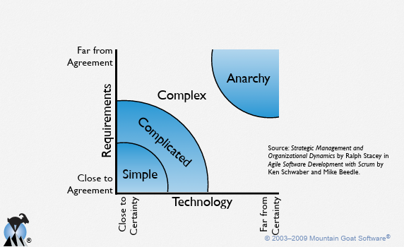
Project noise level

Slide 7
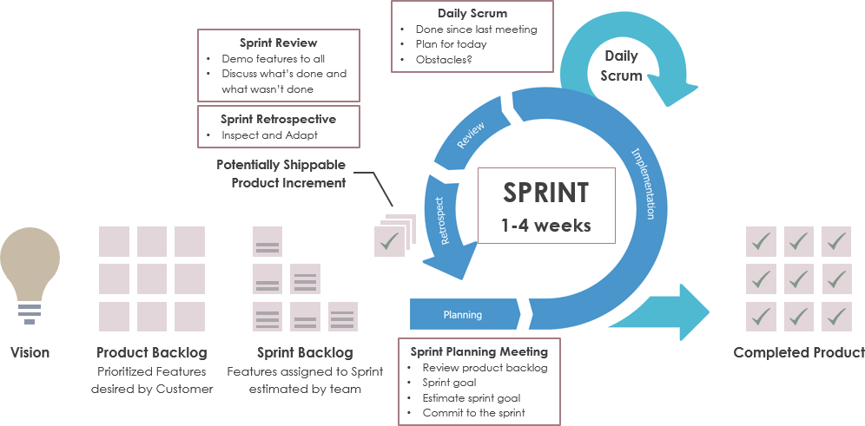
Scrum
Source: https://www.visual-paradigm.com/scrum/what-is-product-backlog-in-scrum/

Slide 8
Sprints
Scrum projects make progress in a series of “sprints”
Typical duration is 1–4 weeks or a calendar month at most
A constant duration leads to a better rhythm
Product is designed, coded, and tested during the sprint

Slide 9
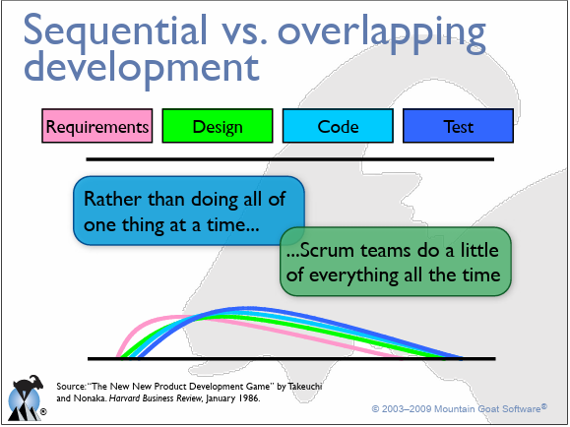

Slide 10
No changes during a sprint
In Agile Scrum, one of the key principles is to embrace change, but the changes introduced during a sprint are generally discouraged. The idea is to have a stable sprint backlog and a defined set of goals for the sprint. This helps the development team focus on delivering a potentially shippable product increment by the end of the sprint.
However, there are situations where changes may need to be accommodated during a sprint.

Slide 11
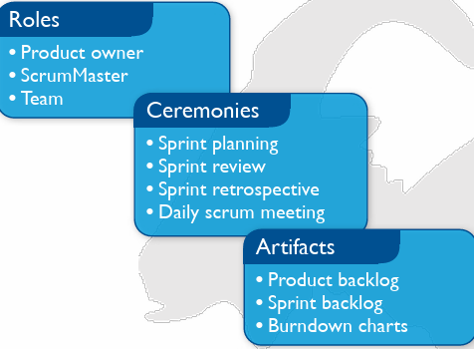
Scrum Framework

Slide 12

Product owner
Define the features of the product
Makes scope vs. schedule decisions
Responsible for achieving financial goals of the project
Prioritize the product backlog
Adjust features and priority every sprint, as needed
Accept or reject work results
Notes:
In Scrum, the Product Owner is a key role responsible for representing the interests of the stakeholders and ensuring that the Scrum Team delivers value to the business. The Product Owner plays a crucial role in defining and prioritizing the product backlog, which is a dynamic and ordered list of product requirements.
Here are some key responsibilities of the Product Owner:
Product Backlog Management: The Product Owner is responsible for creating and maintaining the product backlog. This involves gathering requirements, defining user stories, and prioritizing backlog items based on business value.
Prioritization: The Product Owner decides the order in which features and functionalities are developed. This decision is based on factors such as business value, customer feedback, market conditions, and the overall product strategy.
Communication: The Product Owner acts as a bridge between the development team and stakeholders. They communicate the product vision, goals, and priorities to the team and gather feedback from stakeholders to inform decision-making.
Acceptance Criteria: The Product Owner defines acceptance criteria for user stories, providing guidance to the development team on what needs to be delivered to meet the requirements and satisfy stakeholders.
Release Planning: The Product Owner is involved in release planning, helping to determine what features will be included in each release based on the priorities and goals of the product.
Decision-Making: The Product Owner has the authority to make decisions about the product and its features. They work closely with stakeholders to understand their needs and make informed decisions that align with the overall product strategy.
Availability: The Product Owner is expected to be available to the development team throughout the sprint to provide clarifications, answer questions, and make timely decisions. This helps to ensure a smooth and efficient development process.
It's important for the Product Owner to collaborate closely with the Scrum Team (Development Team and Scrum Master) to achieve the goals of each sprint and deliver a valuable product increment. The Product Owner role requires a good understanding of the business, the market, and the needs of the stakeholders, as well as effective communication and decision-making skills

Slide 13
Product owner cont..
The Product Owner in Scrum is not necessarily the person who originally requested the development of the product, and they may not be the original customer. The Product Owner is a specific role within the Scrum framework and has a set of responsibilities that revolve around managing the product backlog, prioritizing features, and representing the interests of stakeholders.
While the Product Owner should have a deep understanding of the product and its users, their role is more focused on defining what needs to be built and in what order, rather than necessarily being the person who initiated the project.
Notes:
In Scrum, the Product Owner is a key role responsible for representing the interests of the stakeholders and ensuring that the Scrum Team delivers value to the business. The Product Owner plays a crucial role in defining and prioritizing the product backlog, which is a dynamic and ordered list of product requirements.
Here are some key responsibilities of the Product Owner:
Product Backlog Management: The Product Owner is responsible for creating and maintaining the product backlog. This involves gathering requirements, defining user stories, and prioritizing backlog items based on business value.
Prioritization: The Product Owner decides the order in which features and functionalities are developed. This decision is based on factors such as business value, customer feedback, market conditions, and the overall product strategy.
Communication: The Product Owner acts as a bridge between the development team and stakeholders. They communicate the product vision, goals, and priorities to the team and gather feedback from stakeholders to inform decision-making.
Acceptance Criteria: The Product Owner defines acceptance criteria for user stories, providing guidance to the development team on what needs to be delivered to meet the requirements and satisfy stakeholders.
Release Planning: The Product Owner is involved in release planning, helping to determine what features will be included in each release based on the priorities and goals of the product.
Decision-Making: The Product Owner has the authority to make decisions about the product and its features. They work closely with stakeholders to understand their needs and make informed decisions that align with the overall product strategy.
Availability: The Product Owner is expected to be available to the development team throughout the sprint to provide clarifications, answer questions, and make timely decisions. This helps to ensure a smooth and efficient development process.
It's important for the Product Owner to collaborate closely with the Scrum Team (Development Team and Scrum Master) to achieve the goals of each sprint and deliver a valuable product increment. The Product Owner role requires a good understanding of the business, the market, and the needs of the stakeholders, as well as effective communication and decision-making skills

Slide 14
Product owner cont..
The person who originally requested the development of the product might be a stakeholder or a key sponsor, but they might not be directly involved in day-to-day decisions about the product backlog or priorities. The Product Owner collaborates with stakeholders, gathers input, and makes decisions about what features to include in the product based on factors like business value, market needs, and user feedback.
In summary, the Product Owner is a role that facilitates effective communication between stakeholders and the development team, and they are responsible for maximizing the value delivered by the team. The specific individual serving as the Product Owner could come from various backgrounds within the organization and may or may not be the person who initiated the project or requested the product development.
Notes:
In Scrum, the Product Owner is a key role responsible for representing the interests of the stakeholders and ensuring that the Scrum Team delivers value to the business. The Product Owner plays a crucial role in defining and prioritizing the product backlog, which is a dynamic and ordered list of product requirements.
Here are some key responsibilities of the Product Owner:
Product Backlog Management: The Product Owner is responsible for creating and maintaining the product backlog. This involves gathering requirements, defining user stories, and prioritizing backlog items based on business value.
Prioritization: The Product Owner decides the order in which features and functionalities are developed. This decision is based on factors such as business value, customer feedback, market conditions, and the overall product strategy.
Communication: The Product Owner acts as a bridge between the development team and stakeholders. They communicate the product vision, goals, and priorities to the team and gather feedback from stakeholders to inform decision-making.
Acceptance Criteria: The Product Owner defines acceptance criteria for user stories, providing guidance to the development team on what needs to be delivered to meet the requirements and satisfy stakeholders.
Release Planning: The Product Owner is involved in release planning, helping to determine what features will be included in each release based on the priorities and goals of the product.
Decision-Making: The Product Owner has the authority to make decisions about the product and its features. They work closely with stakeholders to understand their needs and make informed decisions that align with the overall product strategy.
Availability: The Product Owner is expected to be available to the development team throughout the sprint to provide clarifications, answer questions, and make timely decisions. This helps to ensure a smooth and efficient development process.
It's important for the Product Owner to collaborate closely with the Scrum Team (Development Team and Scrum Master) to achieve the goals of each sprint and deliver a valuable product increment. The Product Owner role requires a good understanding of the business, the market, and the needs of the stakeholders, as well as effective communication and decision-making skills

Slide 15
The scrum master
Responsible for enacting Scrum values and practices
Removes impediments
Coaches the team to their best possible performance
Helps to improve team productivity in any way possible
Enable close cooperation across all roles and functions
Shield the team from external interference

Slide 16
The scrum master cont..
The Scrum Master is a crucial role within the Scrum framework, and their primary responsibility is to facilitate the Scrum process and help the Scrum Team (Development Team, Product Owner, and themselves) work effectively. The Scrum Master serves as a coach, mentor, and facilitator, ensuring that the team follows Scrum practices and principles to deliver value to the customer.

Slide 17
Role of scrum master
Facilitation: The Scrum Master facilitates Scrum events, such as Sprint Planning, Daily Standups, Sprint Reviews, and Sprint Retrospectives. They help ensure that these events are productive, time-boxed, and achieve their intended goals.
Coaching and Mentoring: The Scrum Master coaches the Scrum Team and the organization on Scrum practices, principles, and values. They help individuals and teams understand their roles and responsibilities within the Scrum framework.
Removing Impediments: The Scrum Master identifies and removes impediments or obstacles that hinder the progress of the Scrum Team. This involves working with the team to address challenges and collaborating with the organization to eliminate roadblocks.
Servant Leadership: The Scrum Master embodies a servant leadership approach, serving the needs of the team and the organization. They foster a culture of collaboration, openness, and continuous improvement.

Slide 18
Role of scrum master cont..
Continuous Improvement: The Scrum Master promotes a culture of continuous improvement within the team. This involves facilitating retrospectives to reflect on what went well, what could be improved, and implementing changes to enhance team effectiveness.
Protecting the Team: The Scrum Master shields the team from external distractions and interruptions, allowing them to focus on their work during the sprint. They also ensure that the team is not overburdened with tasks and commitments.
Monitoring and Metrics: The Scrum Master helps the team understand and use appropriate metrics to monitor progress and identify areas for improvement. This may include burndown charts, velocity, and other relevant measures.
Promoting Scrum Values: The Scrum Master helps to instill the Scrum values of commitment, courage, focus, openness, and respect within the team. They encourage a positive and collaborative working environment.
It's important to note that while the Scrum Master plays a critical role in facilitating and supporting the Scrum process, they do not have authority over the team. Instead, they act as a servant-leader, guiding and assisting the team in their self-organization and continuous improvement journey.

Slide 19
Development team
Typically 3-9 people
Cross-functional:
Programmers, testers, user experience designers, etc.
Members should be full-time
May be exceptions (e.g., database administrator)
Teams are self-organizing
Ideally, no titles but rarely a possibility
Membership should change only between sprints
Notes:
In Scrum, multiple teams can work on multiple Sprints in parallel. This approach is known as "Scrum of Scrums" and is used when a single Scrum Team cannot accomplish all the work required for a product within a reasonable timeframe. This situation often arises in larger projects or in organizations with a significant amount of work to be done.
Here's how it works:
Scrum of Scrums:
When multiple Scrum Teams are working on the same product, they coordinate their efforts through a mechanism called the "Scrum of Scrums." This is an additional meeting that involves representatives from each Scrum Team.
Scrum of Scrums Meeting:
The Scrum of Scrums meeting is typically held at a regular cadence, often daily or a few times per week.
Each Scrum Team sends one or more representatives (usually the Scrum Master or a designated team member) to attend the Scrum of Scrums meeting.
Coordination and Communication:
During the Scrum of Scrums meeting, representatives share updates on their team's progress, discuss any dependencies or impediments, and coordinate efforts to ensure alignment across teams.
Backlog Coordination:
The individual Scrum Teams maintain their own Product Backlogs, but there is often a need for coordination at a higher level to ensure that the overall product goals are being addressed.
The Product Owners from each team may collaborate to align priorities and ensure that the work being done by each team contributes to the overall product vision.
Scaling Agile Frameworks:
In larger organizations, frameworks like the Scaled Agile Framework (SAFe) or Large Scale Scrum (LeSS) may be employed to provide additional structures for coordinating multiple teams working on a common product.
While multiple teams can work in parallel on different Sprints, it's crucial to maintain close communication and coordination to avoid conflicts, ensure alignment with the overall product goals, and address dependencies effectively. The Scrum of Scrums is one way to facilitate this coordination, but organizations may adopt additional practices or frameworks based on their specific needs and scale.

Slide 20
The team
The Scrum Team is a cross-functional group of individuals working together to deliver a potentially shippable product increment at the end of every Sprint in the Scrum framework. The three primary roles within the Scrum Team are the Development Team, the Product Owner, and the Scrum Master.
Development Team:
The Development Team consists of professionals who do the work of delivering a potentially releasable product increment at the end of each Sprint.
It is typically a cross-functional group that includes software developers, testers, designers, and any other roles necessary to deliver a complete product.
The team is self-organizing, meaning they determine how to accomplish the work and are responsible for managing their own tasks and commitments.
The size of the Development Team is usually between three to nine members, with the idea that smaller teams promote better communication and collaboration.
Product Owner:
The Product Owner is a single individual who represents the voice of the customer and stakeholders. They are responsible for maximizing the value of the product and the work of the Development Team.
The Product Owner defines and prioritizes the product backlog, ensuring that the team is working on the most valuable features and improvements first.
They make decisions about what gets built, provide clarity on product backlog items, and ensure that the team understands the overall goals and vision for the product.
Scrum Master:
The Scrum Master is a servant-leader who supports both the Development Team and the Product Owner in their roles. They are responsible for ensuring that the Scrum process is understood and followed.
The Scrum Master helps the team navigate challenges, removes impediments, and facilitates Scrum events. They also promote a culture of continuous improvement within the team.
While the Scrum Master is a guide and coach, they do not have authority over the team. Instead, they help the team self-organize and make their own decisions.
The Scrum Team works in time-boxed iterations called Sprints, typically lasting one to four weeks. During each Sprint, the team collaborates to deliver a potentially shippable product increment. The iterative and incremental nature of Scrum allows for flexibility and adaptability, enabling the team to respond to changing requirements and deliver value regularly.
Notes:
it is entirely possible to have one Scrum Master, one Product Owner, and multiple Development Teams working on multiple Sprints in parallel within the Scrum framework. This is a common scenario, especially in larger projects or organizations where the scope of work is extensive, and a single team cannot handle all the tasks within a reasonable timeframe.
In such a setup:
Scrum Master:
There is typically one Scrum Master who serves as a facilitator and coach for the Scrum Teams. The Scrum Master works to remove impediments, facilitates Scrum events, and ensures that the Scrum framework is followed by all teams.
Product Owner:
There is one Product Owner who represents the interests of stakeholders, manages the product backlog, and prioritizes the work to be done across all the Development Teams. The Product Owner collaborates with each team to ensure a unified vision and prioritize features.
Development Teams:
Multiple Development Teams work on their respective Sprints, each focusing on a subset of the overall work. Each team is responsible for delivering a potentially shippable product increment at the end of its Sprint.
Sprints in Parallel:
Each Development Team operates independently, running its own Sprint and following the Scrum events and artifacts. The Sprints for different teams can be synchronized or staggered, depending on the organization's needs.
Scrum of Scrums:
The Scrum Master and representatives from each Development Team may participate in a Scrum of Scrums meeting to coordinate efforts, discuss dependencies, and address any cross-team impediments. This meeting helps maintain alignment across teams.
Product Backlog Coordination:
The Product Owner works to ensure that the product backlog reflects the overall priorities for the product. They collaborate with each Development Team to clarify requirements and ensure that the work aligns with the product vision.
This approach allows organizations to scale Scrum to handle larger and more complex projects while still benefiting from the transparency, inspection, and adaptation principles of the Scrum framework. Coordination and communication are essential to the success of this model, and the Scrum of Scrums provides a mechanism for addressing challenges and dependencies across teams. Additionally, some organizations may adopt scaled agile frameworks, such as the Scaled Agile Framework (SAFe) or Large Scale Scrum (LeSS), to provide additional structures for coordinating multiple teams.

Slide 21
Sprint planning
Sprint Planning is a key event in the Scrum framework that occurs at the beginning of each Sprint. It is a collaborative session involving the entire Scrum Team (Development Team, Product Owner, and Scrum Master) and is time-boxed to a specific duration, typically one to two hours per week of the Sprint.
The primary goal of Sprint Planning is to define what can be delivered in the upcoming Sprint and how it will be achieved.

Slide 22
Sprint planning cont..
The event is divided into two parts:
Part 1: What can be done in this Sprint? (What):
The Product Owner presents the prioritized Product Backlog items to the Development Team.
The team collaborates with the Product Owner to gain a clear understanding of the requirements and to discuss any ambiguities or questions.
The team estimates the effort required to complete each Product Backlog item, often using techniques like story points or time estimates.
The team and the Product Owner negotiate and agree on the scope of work to be included in the Sprint.
Part 2: How will the chosen work get done? (How):
The Development Team collaborates to create a plan on how they will deliver the committed work during the Sprint.
This involves breaking down the selected Product Backlog items into tasks and defining the tasks that need to be completed to deliver the increment.
The team discusses dependencies, technical considerations, and any impediments that might impact their ability to deliver the planned work.
The team may adjust their capacity and forecast based on their discussions and understanding of the work.
At the end of Sprint Planning, the Scrum Team should have a shared understanding of the Sprint Goal, the selected Product Backlog items, and the plan for how to achieve the goal. The outcome of Sprint Planning is a Sprint Backlog, which is a list of tasks and activities the team has committed to completing during the Sprint.
It's important to note that the Sprint Planning meeting is a dynamic and collaborative process, and it sets the direction for the upcoming Sprint. It fosters transparency, communication, and alignment within the Scrum Team.
Notes:
In the Scrum framework, the primary interaction between the customer and the Scrum Team usually occurs through the Product Owner. The Product Owner is responsible for representing the customer, stakeholders, and the business, and they work closely with the team to define and prioritize the requirements.
Here's how the process typically works:
Product Owner and Customer Interaction:
The Product Owner is the key point of contact between the Scrum Team and the customer or stakeholders.
The Product Owner engages with the customer to gather requirements, understand their needs, and prioritize features based on business value.
They work to create a well-defined product backlog that captures the features, user stories, and other items that need to be implemented.
Product Owner's Role in Sprint Planning:
During Sprint Planning, the Product Owner presents the prioritized product backlog items to the Development Team.
The Product Owner collaborates with the team to provide insights into the requirements, answer questions, and clarify any uncertainties.
The goal is to ensure that the team has a clear understanding of what needs to be delivered and can make informed decisions about the scope of work for the upcoming Sprint.
Scrum Master's Role:
While the Scrum Master is not typically involved in direct discussions with the customer during Sprint Planning, they play a supportive role in facilitating communication within the Scrum Team.
The Scrum Master may work with the Product Owner and the team to ensure that the customer's needs are well understood, and any impediments or challenges in gathering requirements are addressed.
It's not a common practice for the entire Scrum Team, including the Scrum Master, to sit directly with the customer to gather requirements during Sprint Planning. The Product Owner serves as the bridge between the customer and the development team, ensuring a clear understanding of requirements and priorities.
However, the Scrum Team may periodically engage with customers or stakeholders during Sprint Review meetings, where the increment is demonstrated, and feedback is gathered. This feedback loop helps in refining future product increments and ensures that the product aligns with customer expectations.

Slide 23
Sprint review
The Sprint Review is an essential ceremony in the Scrum framework, occurring at the end of each Sprint. It involves the Scrum Team, stakeholders, and sometimes the product's end-users. The primary purpose of the Sprint Review is to inspect the increment of the product developed during the Sprint and gather valuable feedback for further refinement.

Slide 24
Sprint review cont..
Here's a breakdown of the Sprint Review process:
Preparation:
The Product Owner prepares the product increment for review by the stakeholders. This includes making sure that the features or user stories completed during the Sprint are ready for demonstration.
Invitation:
The Scrum Master invites relevant stakeholders, such as customers, end-users, managers, and other interested parties, to attend the Sprint Review. The goal is to ensure that those who have an interest in the product are present to provide feedback.
Demonstration:
The Development Team demonstrates the functionality that was completed during the Sprint. The focus is on showcasing the increment, explaining the new features, and highlighting any changes made to existing functionality.
The demonstration is not just a presentation; it should be interactive, allowing stakeholders to ask questions and provide immediate feedback.
Feedback and Collaboration:
Stakeholders, including the Product Owner, provide feedback on the demonstrated increment. This feedback can cover various aspects, such as the completeness of features, usability, and alignment with business goals.
The Scrum Team and stakeholders collaborate to understand the feedback and discuss potential adjustments or improvements. This interaction fosters transparency and collaboration.
Review of the Product Backlog:
The Product Owner reviews and, if necessary, adjusts the product backlog based on the feedback received during the Sprint Review. This ensures that the backlog reflects the most current priorities and understanding of the product's requirements.
Retrospective Aspect:
The Sprint Review serves, in part, as an informal retrospective. The team reflects on what went well during the Sprint, what could be improved, and how the development process can be enhanced in the future.
Sprint Review Meeting Time-Box:
The Sprint Review is time-boxed, with its duration generally proportionate to the length of the Sprint. For example, in a two-week Sprint, the Sprint Review may last up to two hours.
Continuous Improvement:
The insights gained during the Sprint Review contribute to continuous improvement. The team uses this feedback to refine their understanding of user needs, adjust priorities, and enhance their development practices.
The Sprint Review, along with the Sprint Retrospective, helps the Scrum Team maintain an adaptive and iterative approach, allowing them to respond effectively to changing requirements and improve their processes over time.

Slide 25
Sprint retrospective
The Sprint Retrospective is a crucial event in the Scrum framework that occurs at the end of each Sprint. Its primary purpose is to provide the Scrum Team with an opportunity to reflect on the Sprint that has just concluded and to identify areas for improvement. The retrospective is a key aspect of Scrum's commitment to continuous improvement.
Here is an overview of the Sprint Retrospective process:
Notes:
The Sprint Retrospective in Scrum is primarily an internal meeting for the Scrum Team, which includes the Development Team, Product Owner, and Scrum Master. The goal is for the team to reflect on the just-completed Sprint, discuss what went well, what could be improved, and identify action items for continuous improvement. The focus is on the internal workings of the team and its processes.
While the primary audience for the Sprint Retrospective is the Scrum Team, there may be cases where the Scrum Master or Product Owner decides to invite external stakeholders, including customers or end-users. However, this is not a common practice, and it should be done judiciously.
Here are some considerations:
Focus on Team Dynamics:
The Sprint Retrospective is designed to be a safe space for the team to openly discuss their experiences and identify improvements. Including external stakeholders might change the dynamics and make team members hesitant to share openly.
Transparency and Trust:
The retrospective relies on transparency and trust within the Scrum Team. If the team feels that external stakeholders' presence may impact their ability to be candid, it could hinder the effectiveness of the retrospective.
Specific Context:
If there are specific reasons or circumstances that make it beneficial to include customers or end-users, such as obtaining direct feedback on a recent release or a particular aspect of the product, it might be appropriate to invite them selectively.
Alternative Feedback Channels:
While the Sprint Retrospective is a valuable forum for internal reflection, obtaining feedback from customers and end-users can be achieved through other channels, such as user surveys, focus groups, or direct communication outside the retrospective setting.
In summary, while it's not the norm to include customers or end-users in the Sprint Retrospective, there might be situations where their presence is beneficial or warranted. It's essential to carefully consider the context, team dynamics, and the goals of the retrospective before deciding to involve external stakeholders. If their input is valuable, alternative channels for feedback might be explored to maintain the integrity and effectiveness of the retrospective as a tool for internal team improvement.

Slide 26
Sprint retrospective cont..
Time-Boxed Meeting:
The Sprint Retrospective is a time-boxed meeting, typically lasting around 1 to 1.5 hours, depending on the length of the Sprint.
Attendees:
The core participants in the Sprint Retrospective include the members of the Scrum Team: the Development Team, the Product Owner, and the Scrum Master.
Facilitation:
The Scrum Master facilitates the retrospective. They guide the team through the process, ensuring that the discussion remains constructive and focused on continuous improvement.
Reflecting on the Sprint:
The team reflects on the just-completed Sprint, discussing what went well and what could be improved. This reflection covers various aspects, including processes, teamwork, communication, and any challenges faced during the Sprint.
Identification of Strengths and Areas for Improvement:
The team identifies and discusses both positive aspects (what went well) and areas for improvement (what could be done differently or better) during the Sprint.
This can include technical practices, collaboration methods, and any challenges or impediments that impacted the team's ability to meet its goals.

Slide 27
Sprint retrospective cont..
Action Items:
The team collaboratively generates action items or specific changes to implement in the next Sprint. These action items are designed to address the identified areas for improvement.
Action items are actionable, measurable, and typically framed as experiments or changes to the team's working agreements.
Follow-Up:
The Scrum Master ensures that the action items are documented and tracked. The progress on these action items becomes part of the agenda for the next retrospective.
Open and Honest Communication:
The retrospective is an opportunity for open and honest communication within the team. Team members are encouraged to share their perspectives and contribute to the identification of improvement opportunities.
Positive Reinforcement:
It's essential to celebrate successes and achievements during the Sprint. Recognizing and reinforcing positive aspects contributes to a positive team culture.
Continuous Improvement:
The Sprint Retrospective is a mechanism for continuous improvement. By regularly reflecting on their processes and collaboration, the team can adapt and refine their approach to become more effective over time.
The Sprint Retrospective is a valuable part of the Scrum framework, fostering a culture of continuous learning and improvement within the Scrum Team. It complements other Scrum events, such as Sprint Planning and the Sprint Review, to create a dynamic and adaptive development process.

Slide 28
Daily scrum
Parameters
Daily
15-minutes
Stand-up
Not for problem solving
Whole world is invited
Only team members, Scrum Master, product owner, can talk
Helps avoid other unnecessary meetings

Slide 29
Daily scrum cont..
The Daily Scrum, also known as the Daily Standup, is a daily ceremony in the Scrum framework designed to facilitate communication and collaboration within the development team. This short, time-boxed meeting serves as a quick synchronization point to ensure that the team is on track to meet its Sprint goals. The Daily Scrum is typically conducted at the same time and place each day and lasts around 15 minutes.
The Daily Scrum is a vital practice that helps the Development Team stay aligned, communicate effectively, and quickly address any challenges that may arise during the development process. The focus on daily communication contributes to the overall success of the team in achieving its Sprint goals.
Here's an overview of the Daily Scrum process:

Slide 30
Daily scrum cont..
The Daily Scrum, also known as the Daily Standup, is a daily ceremony in the Scrum framework designed to facilitate communication and collaboration within the development team. This short, time-boxed meeting serves as a quick synchronization point to ensure that the team is on track to meet its Sprint goals. The Daily Scrum is typically conducted at the same time and place each day and lasts around 15 minutes.
Here's an overview of the Daily Scrum process:

Slide 31
Daily scrum cont..
Time and Place:
The Daily Scrum is held at a consistent time and place every day. It is often conducted in the morning to allow the team to plan the day's work effectively.
Attendees:
The core participants in the Daily Scrum are members of the Development Team. The Product Owner and Scrum Master may also attend but typically as observers. Other stakeholders are generally not active participants in the meeting.
Standup Format:
The team gathers in a standing position to encourage brevity and focus. The standing format is meant to keep the meeting short and to the point.
Three Questions:
Each team member answers three specific questions:
What did you do yesterday?
What will you do today?
Are there any impediments or blockers in your way?
Team members provide brief updates on their progress, plans for the day, and any challenges they are facing.

Slide 32
Daily scrum cont..
Focus on Collaboration:
The Daily Scrum is a collaborative meeting where team members share information, coordinate activities, and identify potential dependencies or issues that may impact the team's progress.
Scrum Master's Role:
The Scrum Master facilitates the Daily Scrum, ensuring that it stays within the time-box and encouraging the team to stay focused on the three questions.
The Scrum Master may also help the team address any impediments mentioned during the meeting or facilitate discussions on how to overcome challenges.
Product Owner's Role:
The Product Owner may attend the Daily Scrum to stay informed about the team's progress but typically does not actively participate in the answering of the three questions.
No Problem Solving During the Meeting:
The Daily Scrum is not the forum for problem-solving. If there are issues or impediments that require more in-depth discussion, team members can coordinate with each other after the meeting.
Continuous Improvement:
The Daily Scrum provides a daily opportunity for the team to inspect and adapt. It fosters a sense of shared responsibility and encourages continuous improvement in the team's processes.

Slide 33
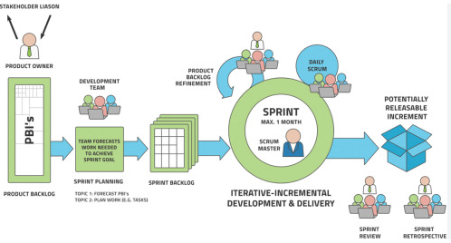
Product backlog
The requirements
A list of all desired work on the project
Ideally expressed such that each item has value to the users or customers of the product
Prioritized by the product owner
Reprioritized at the start of each sprint

Slide 34
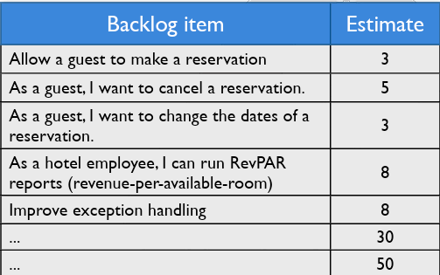
A sample product backlog

Slide 35
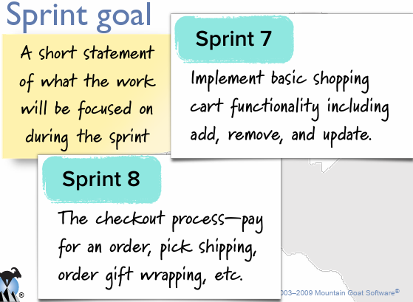
Sprint backlog

Slide 36
Managing the sprint backlog
Individuals sign up for work of their own choosing
Work is never assigned
Estimated work remaining is updated daily
Any team member can add, delete or change the sprint backlog
Work for the sprint emerges
If work is unclear, define a sprint backlog item with a larger amount of time and break it down later
Update work remaining as more becomes known

Slide 37
A sprint burndown chart
A Sprint Burndown Chart is a visual representation of the work completed versus the work remaining in a Sprint over time. It is a valuable tool in Scrum for tracking the progress of a development team during a Sprint and providing a quick, at-a-glance view of how well the team is doing in terms of completing the planned work.
Here's how to understand and interpret a Sprint Burndown Chart:

Slide 38
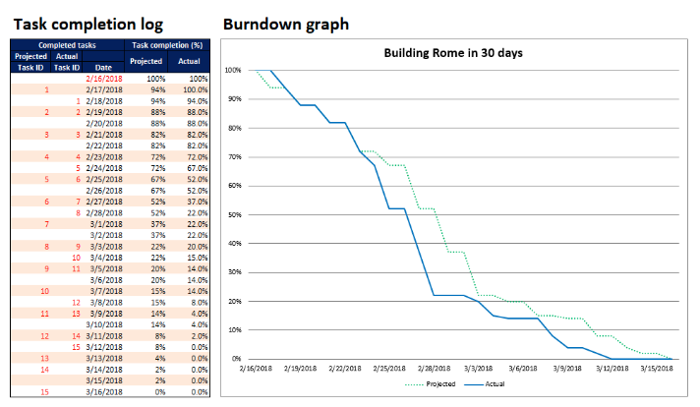
Sample burndown chart
Source: https://www.sqlshack.com/how-to-create-an-advanced-sprint-burn-down-chart-in-excel/

Slide 39
A sprint burndown chart cont..
Y-Axis (Vertical):
Represents the amount of work remaining. This is usually measured in units like story points, ideal hours, or tasks.
X-Axis (Horizontal):
Represents the progression of time during the Sprint. Days or Sprint increments (e.g., daily) are typically used on this axis.
Ideal Trend Line:
The chart often includes an "ideal" trend line that shows how the work remaining should ideally decrease over time if the team completes the planned work at a steady rate. This line connects the total work at the beginning of the Sprint to zero at the end.
Actual Work Remaining:
The actual work remaining is represented by the plotted points or line on the chart. Each point or line segment indicates the amount of work remaining at a specific point in time, usually at the end of each day or at specific intervals during the Sprint.
Interpreting the Chart:
Ideally, the actual work remaining line should closely follow the ideal trend line, indicating that the team is progressing as planned. Deviations from the ideal trend may signal that the team is ahead or behind schedule.
If the actual line is consistently below the ideal trend, the team is ahead of schedule. If it is consistently above, the team is behind schedule.
Significant deviations or sudden changes in the trend may indicate issues or adjustments in the Sprint, and the team may need to inspect and adapt their plans.

Slide 40
A sprint burndown chart cont..
Zero Work Remaining:
The Sprint Burndown Chart ideally reaches zero at the end of the Sprint, indicating that the team has completed all planned work.
The Sprint Burndown Chart serves several purposes:
Visibility: It provides transparency into the team's progress during the Sprint, making it easy to see how much work remains at any given point.
Early Identification of Issues: Deviations from the ideal trend can prompt the team to inspect and adapt their plans, addressing issues or adjusting their approach mid-Sprint if necessary.
Communication: It serves as a communication tool, enabling the team to discuss their progress with stakeholders during Sprint Review meetings.
By regularly updating and reviewing the Sprint Burndown Chart, the team can make data-driven decisions, identify potential challenges early, and work towards completing the Sprint goals successfully.

Slide 41
Kanban
Kanban is an agile methodology that originated in Japan and has its roots in manufacturing. The term "Kanban" is Japanese for “signboard" or “billbord," and the system was first introduced by Taiichi Ohno, an engineer at Toyota, in the late 1940s and early 1950s.
The history of Kanban in the context of agile software development began in the early 2000s. In 2004, David J. Anderson applied Kanban principles to software development while working at Microsoft. He adapted the Kanban system to manage work in a more flexible and efficient way, aiming to improve the flow of work and minimize waste in the software development process.

Slide 42
Kanban cont..
While Scrum is great tool for working with complex projects, it doesn’t have a strict method to deal with change requests.
Kanban is tool for managing the flow of items through a system.
It is a very visual system which allows its participants to visualize the flow of work.
Often uses a Kanban board with different columns to represent the state of a work items (Cards) and swim lanes to show the “flow” lanes.

Slide 43
Principles of Kanban
The foundation of Kanban is based on the following principles:
Visualize your work: Kanban typically uses boards which allow you to move items from one state to another. This allows you to see your work changing from one state to another, and if there is a bottleneck, this easily visible.
Limit your Work in Progress (WIP): Kanban asks you to define what is the maximum work that the team can be engaged in without losing efficiency and asks the team to make sure no more work is being done once this limit it met.
Measure Flow: Since the work is always being visualized, we focus on the “flow” of items in our system from start to finish. Improving the flow means that we improve on our delivery.
Make process policies explicit: As a team identifies opportunities to improve itself, this knowledge is introduced into the Kanban board. For example, we can reestablish of WIP limit if our current value is not working.
Use Models to recognize opportunities: Understand the models of theory of constraints and waster and flow.
Notes:
https://www.leanproduction.com/theory-of-constraints/

Slide 44
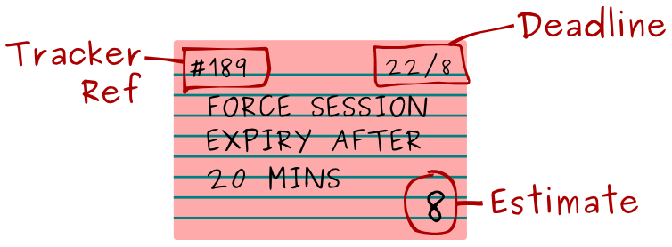
Use Software Development
In Software development, we visualize a work item as a “card”.
These cards represent a piece of work to be done and is placed on a Kanban board.
The card usually contains the following information:
Task name/description
Who it is assigned to
A unique Id
An estimate if applicable
Deadline if any
Other info as desired by the team

Slide 45
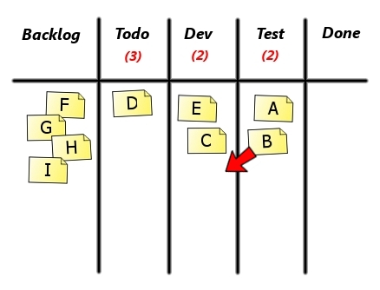
Kanban Board – Software development
The card usually resides on a Kanban board, which contain the different “states” the work item has to travel through to be considered done.
Also, the board will have a state to denote the Ready phase and a state to denote “Done”
Example:

Slide 46
Kanban Board
The development team should be concerned with moving backlog items from the “ready” column to the “done” column.
All work being done by the team should be a card on the board. Remember it is important to visualize the work.
Each column in the Kanban board needs to establish a WIP limit. A WIP limit is an aggregated number of work that the team can handle for that state.
If the WIP limit is reached in a column (indicates a bottleneck), no more work should be pulled until a card is moved from that column.
If the WIP limit must be broken for an urgent item, the team should still focus on resolving the bottleneck immediately.

Slide 47
WIP limit
A Work in Progress (WIP) limit is a fundamental concept in Kanban that sets the maximum number of tasks or work items allowed to be in progress at any given time within a specific stage or column of a Kanban board. The primary purpose of WIP limits is to manage and control the flow of work through the system, preventing teams from overloading themselves and helping to maintain a steady and efficient pace of delivery.
Let's consider an example of a software development team using a Kanban board with Work in Progress (WIP) limits. The board consists of three columns: "To Do," "In Progress," and "Done."
Setting WIP Limits:
The team decides to set WIP limits to manage their work more effectively. They decide on the following WIP limits:
"To Do" column: WIP limit of 5 tasks
"In Progress" column: WIP limit of 3 tasks
"Done" column: No WIP limit (as completed tasks move out of this column quickly)
Initiating Work:
The team starts with an empty board, and they pull in tasks from their backlog into the "To Do" column.
As they pull in tasks, the number of tasks in the "To Do" column increases but must not exceed the WIP limit of 5.

Slide 48
WIP limits cont..
Work in Progress:
As team members begin working on tasks, they move them from the "To Do" column to the "In Progress" column.
The team can have a maximum of 3 tasks actively in progress at any given time.
Managing WIP Limits:
If the team reaches the WIP limit in the "To Do" column (e.g., 5 tasks), they must complete or move tasks to the "In Progress" column before pulling in new tasks.
If the "In Progress" column reaches its WIP limit (e.g., 3 tasks), the team must complete tasks or move them to the "Done" column before starting new work.
Flow and Completion:
The team focuses on completing tasks and moving them across the board to the "Done" column.
As tasks are completed, the team can pull in new tasks from the backlog into the "To Do" column, maintaining a steady flow of work.
Visualizing Issues:
If the team consistently hits WIP limits, it indicates potential issues such as bottlenecks or resource constraints.
The team can use this visual information to adapt their processes, redistribute work, or address impediments to improve overall flow.
Continuous Improvement:
The team regularly reviews its Kanban board and WIP limits during retrospective meetings.
Based on their observations and feedback, they may adjust WIP limits to better match their capacity and optimize the flow of work.

Slide 49
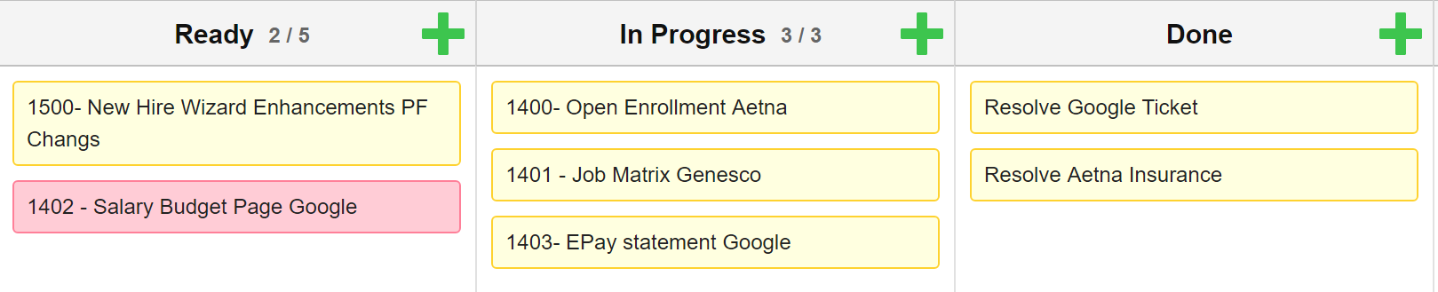
Kanban Board
An example of a Kanban board with WIP Limits:

Slide 50
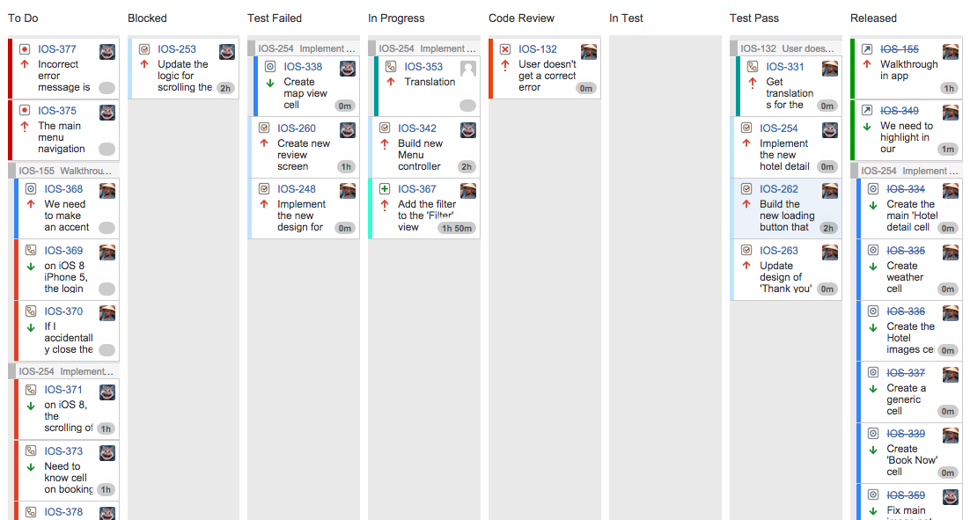
Example of A JIRA KANBAN BORAD

